Slide 1
Food 101
Michał Mróz, Magdalena Słonińska
(The Beautiful Ducklings)

Slide 2

Idea proposals
2 high quality datasets – Keggle Recipe Ingredients & Food101
Dish classification based on a photograph/image
List ingredients needed for a dish given an image/type

Slide 3
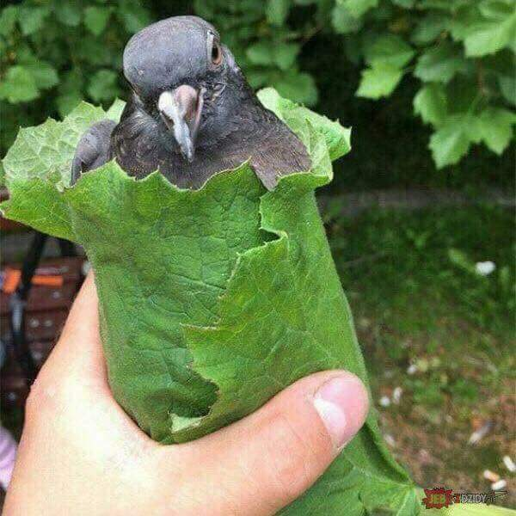
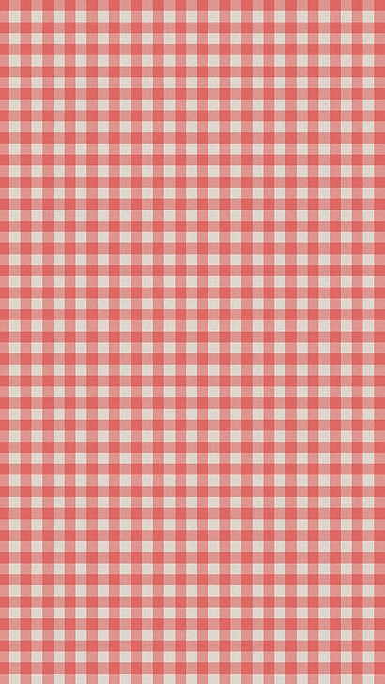
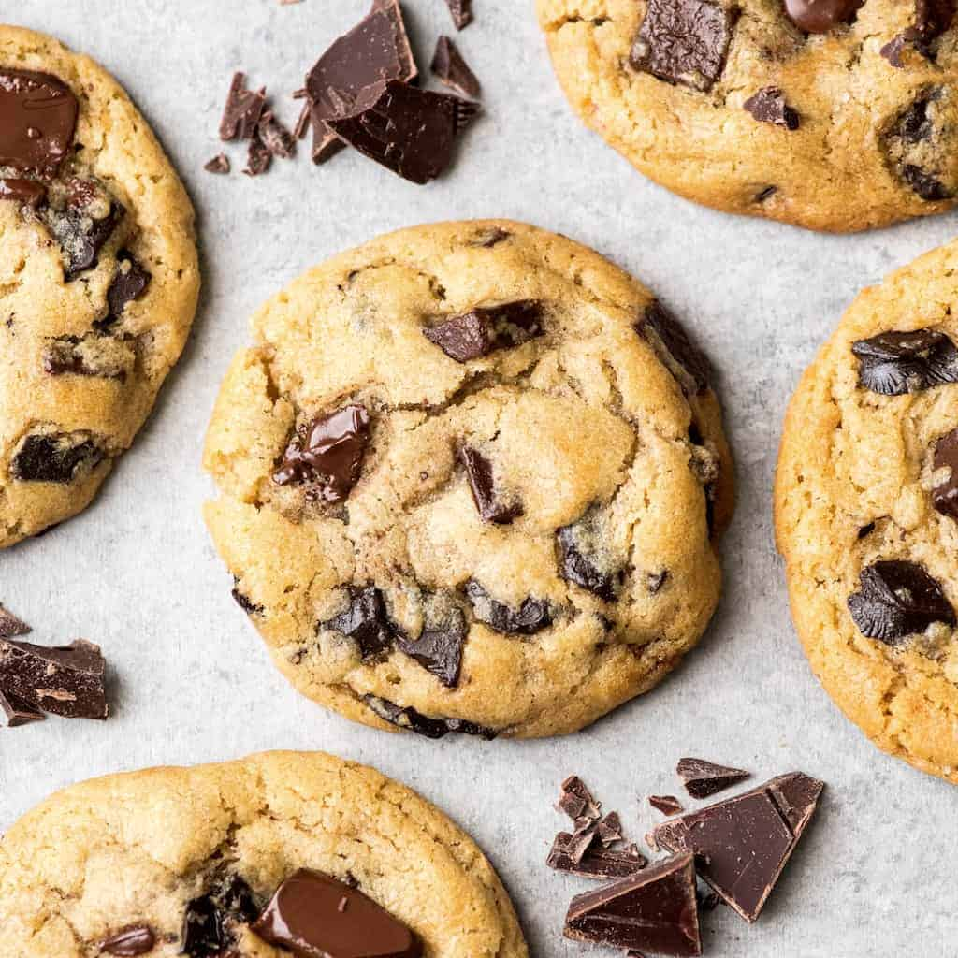
Image recognition
Strategy similar to MNIST classification, but the level of complexity is significantly higher (higher resolution, more categories) - we'll experiment with data batching and image normalization.
gołąbki?
cookies?

Slide 4
Idea proposals
2 high quality datasets – Keggle Recipe Ingredients & Food101
Dish classification based on a photograph/image
List ingredients needed for a dish given an image/type

Slide 5

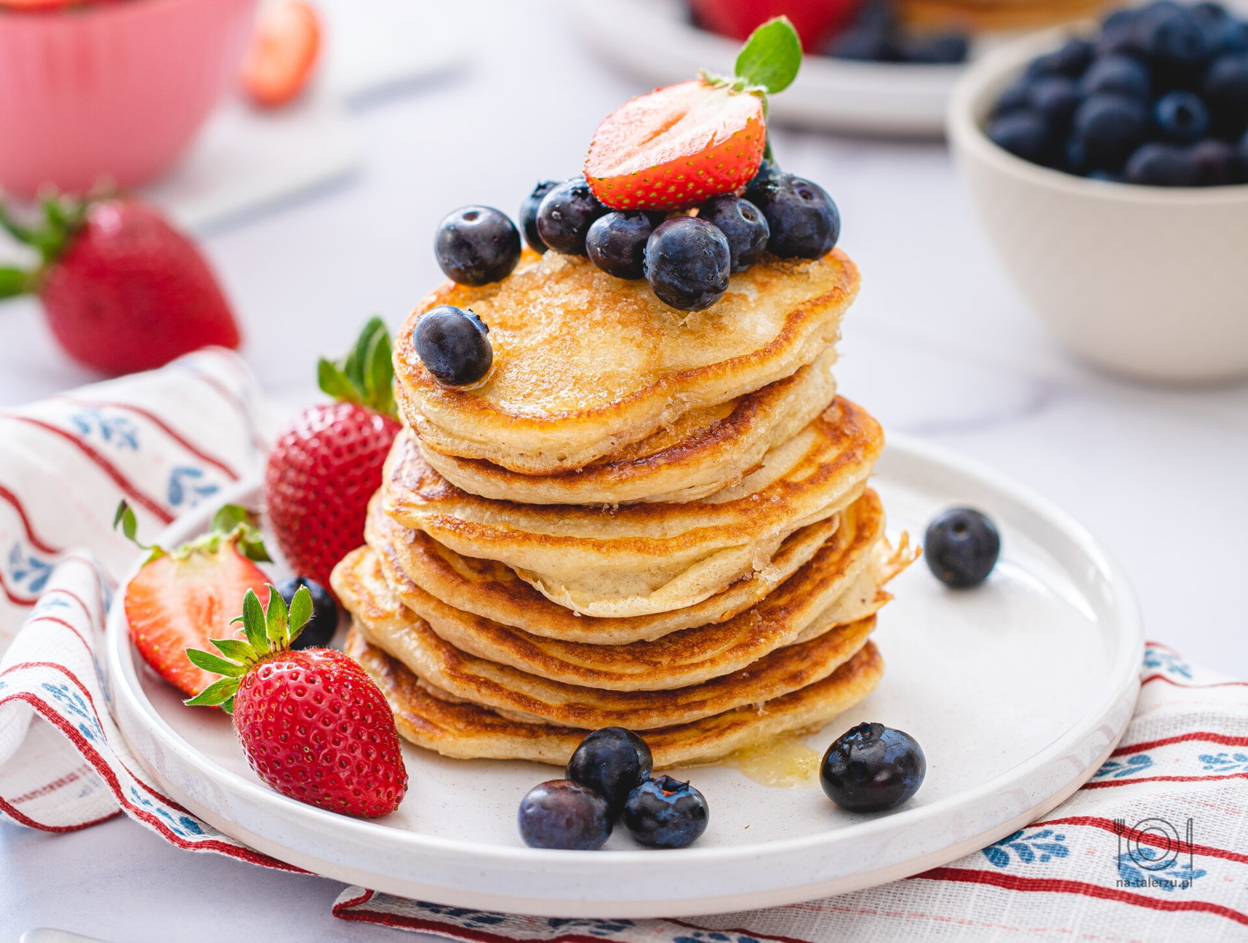
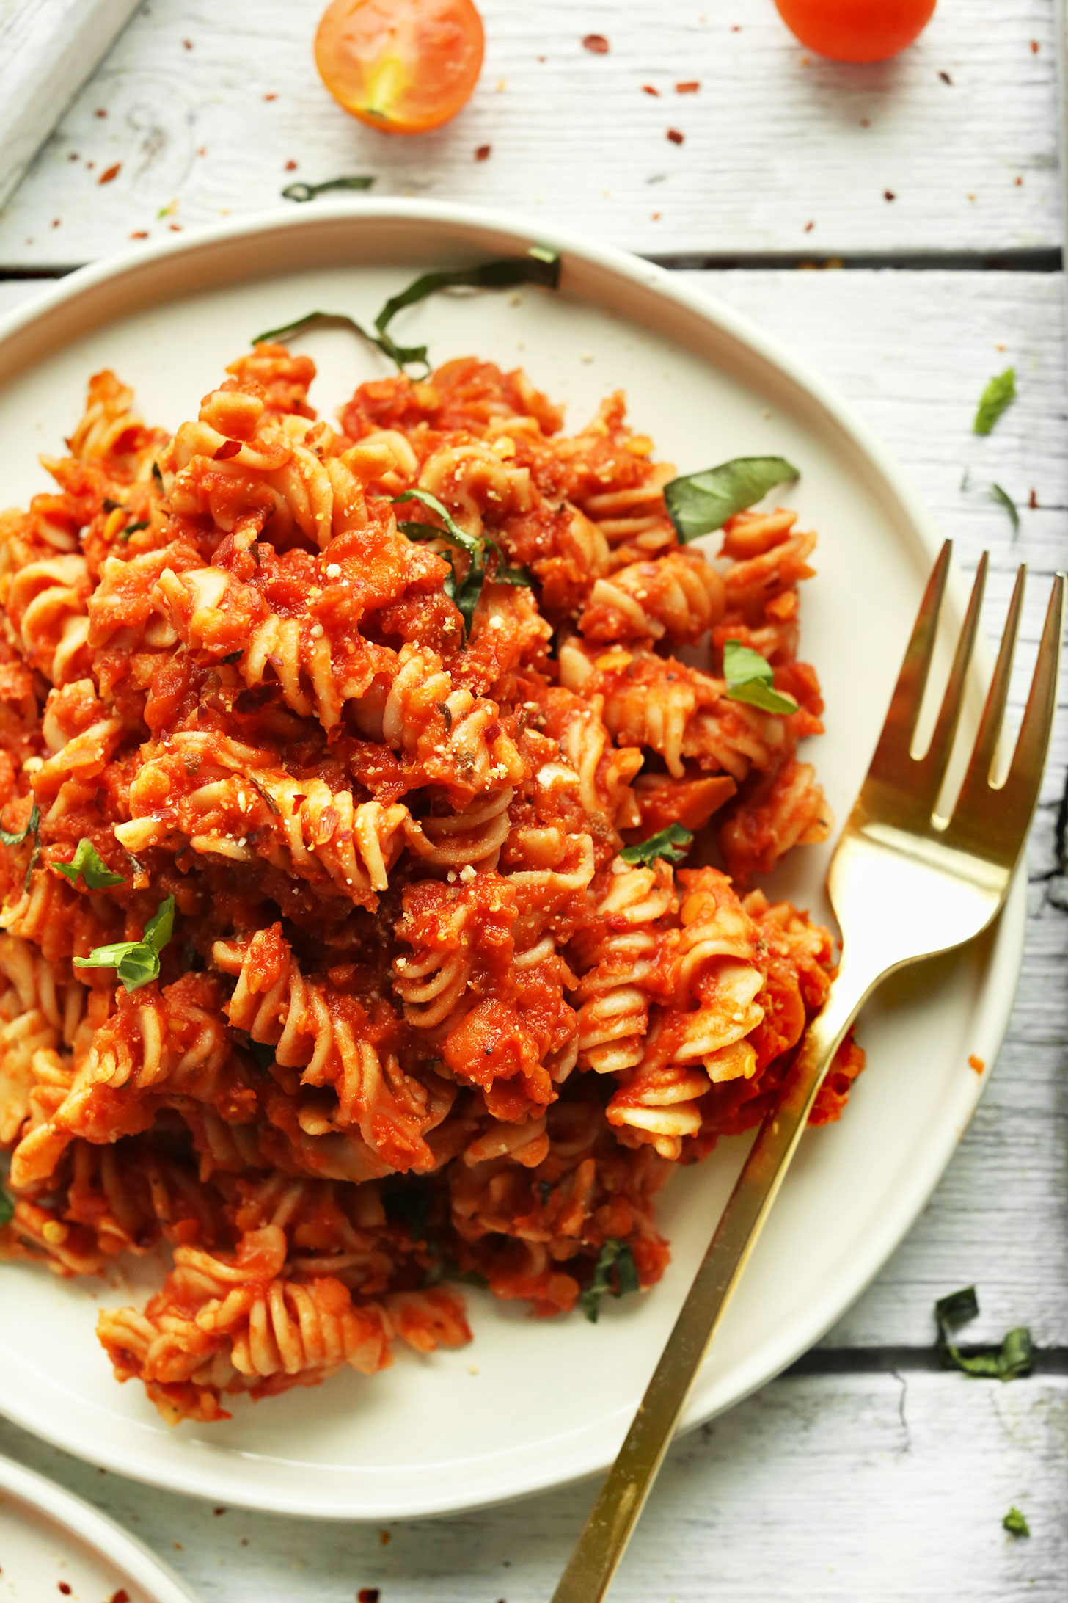

For example...
Pasta, tomatoes, heavy cream
flour, oil, baking soda

Slide 6
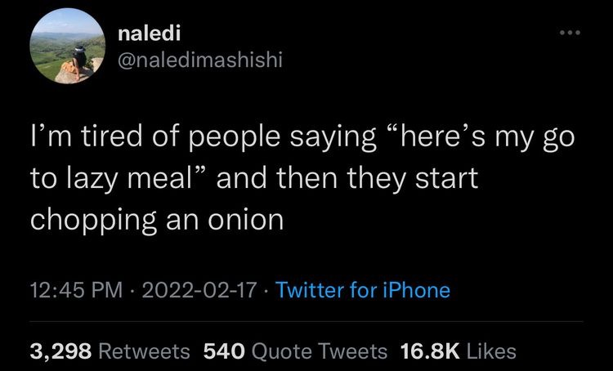
Thoughts? Thank you!

Slide 7
Presentation outline
Team info and project TLDR
What was the problem and the final research question. Why it matters to you
What was the data, what were the techniques
What were the results, are you happy with them
What were the conclusions, what have you learned, what was good or bad?

Slide 8
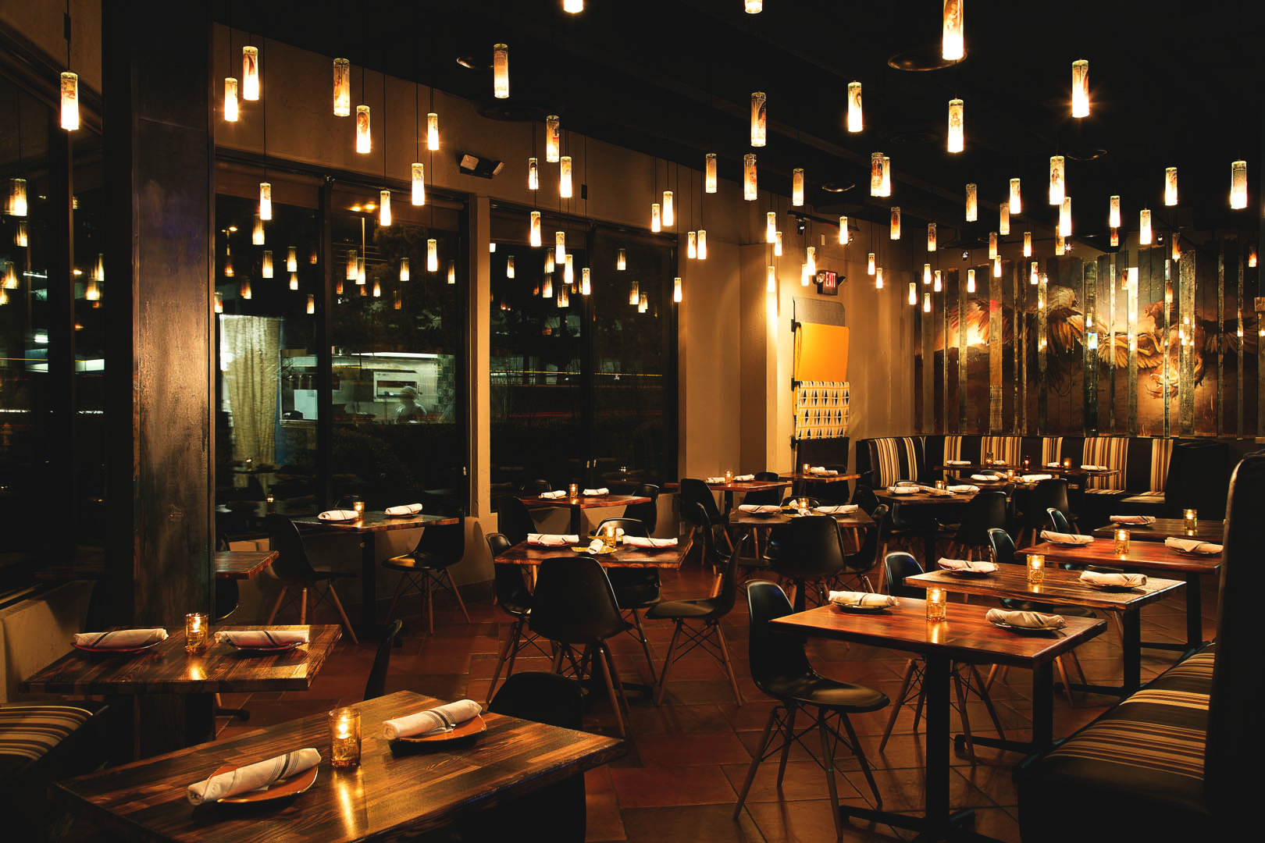
Food 101
Michał Mróz, Magdalena Słonińska

Slide 9
The goal
Given an image of some plate of food... can we tell what kind of dish it is?
gołąbki?
cookies?

Slide 10
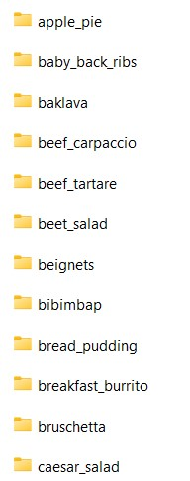
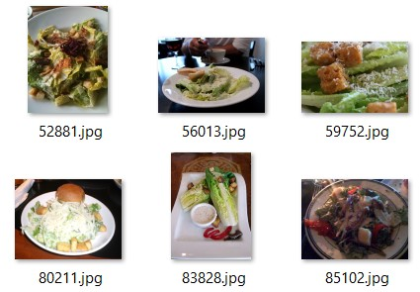
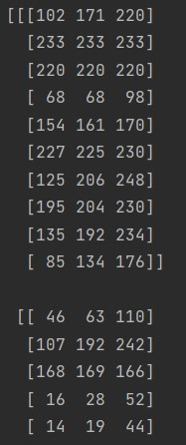

Image processing for dummies
Create image vector
Download
Kaggle dataset
Define "distance"

Slide 11
Results (accuracy in %)
kNN algorithm
Decision trees
# of classes
RGB
greyscale
RGB
greyscale
2
65,8
67,3
69,4
69,2
10
21,3
19,2
17,8
16,1
50
5,3
4,3
3,4
*all images resized to 48 x 48 pixels

Slide 12
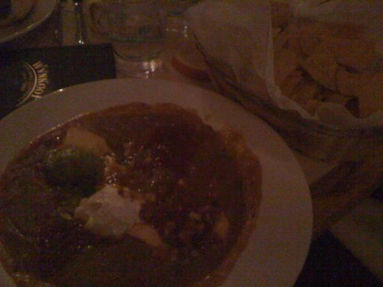
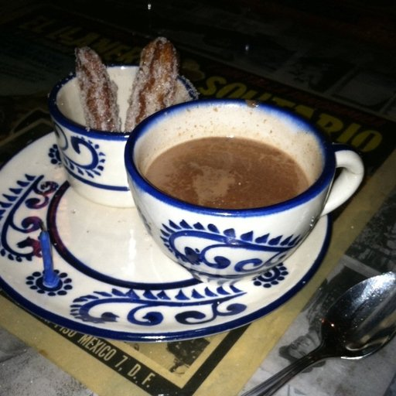
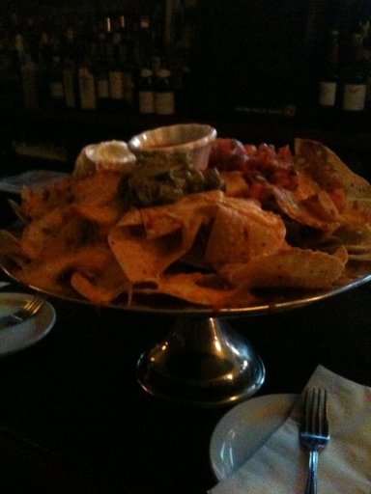
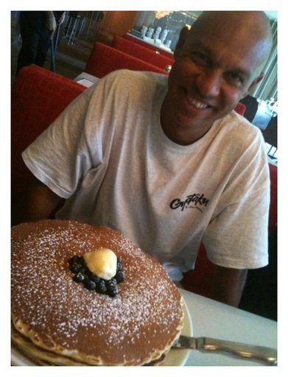
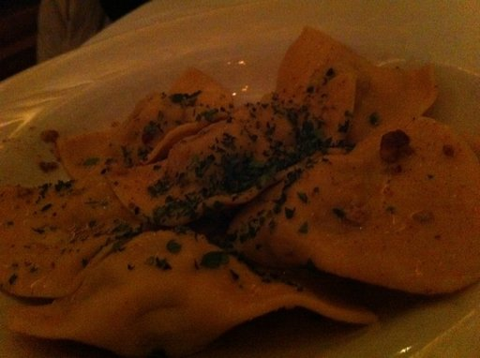


Main issues
2
1

Slide 13
Improvement ideas
Clean up dataset before using it – remove outliers that are extremely blurry or taken at a weird angle
Lots of foods look very similar (colours, presentation etc.) - choose categories very different from one another?
Normalize images so that the dishes are more centered

Slide 14
Thank you!
The Jupyter notebook is available here​

